Slide 1
Cardiovascular diseases
Dr. Armin Pourhosseini

Slide 2
Hypertension: major risk factor for myocardial infarction, heart failure and stroke
<20% of cases: secondary hypertension (pheochromocytoma, coarctation of the aorta, renal vascular disease, adrenal cortical tumors)
primary or essential hypertension: idiopathic
strategies include reductions of blood volume, sympathetic effects, vascular smooth muscle tension, and angiotensin effects.
Unfortunately, in primary hypertension, the baroreceptor reflex and the renin response are reset to maintain the higher blood pressure.

Slide 3
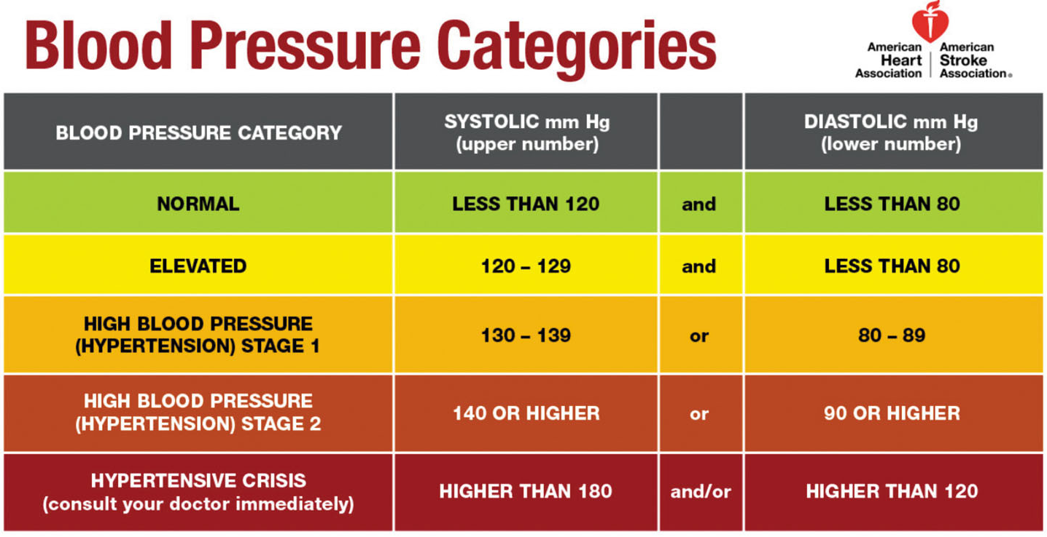

Slide 4
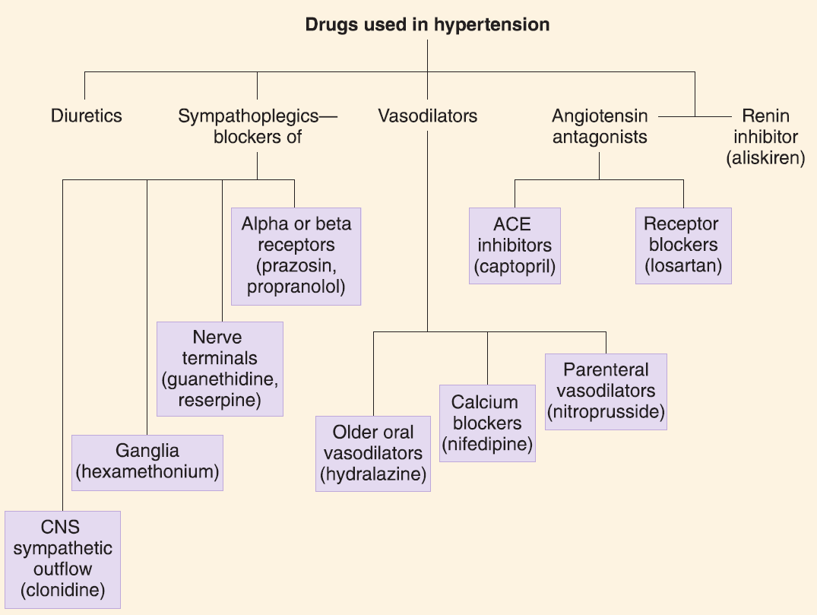

Slide 5
Diuretics
these drugs lower blood pressure by reduction of blood volume and probably also by a direct vascular effect that is not fully understood.
Diuretics used in treating hypertension: thiazides (chlorthalidone, hydrochlorothiazide), loop diuretics (furosemide)
Hypertension, congestive heart failure
The major application of loop diuretics is in the treatment of edematous states (eg, heart failure, ascites, and acute pulmonary edema).

Slide 6
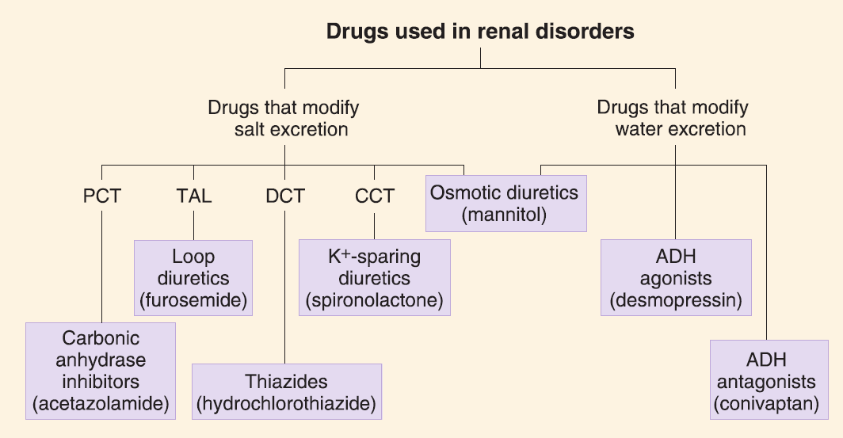

Slide 7
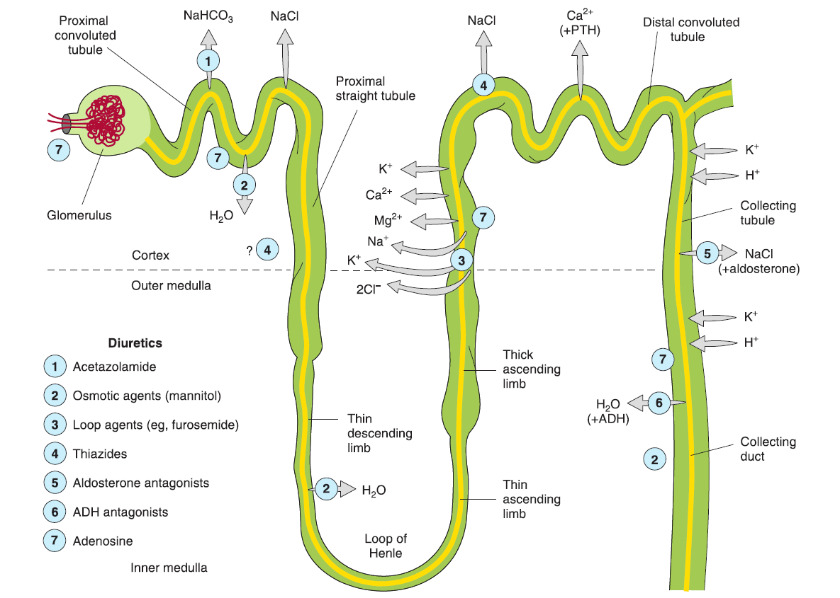

Slide 8
ototoxicity — loop diuretic-induced ototoxicity can lead to transient (usually lasting 30 minutes to 24 hours) or permanent deafness. ototoxicity primarily occurs with high-dose intravenous therapy (eg, furosemide doses above 240 mg/hour) or at lower doses in patients with kidney function impairment or concurrent use of other ototoxins such as aminoglycosides.
ethacrynic acid, which is rarely used, may be more ototoxic in high doses than furosemide, torsemide, and bumetanide.
mechanism — the development of hearing loss is thought to be related to the intrinsic mechanism of loop diuretic action. transport in the loop of henle that is mediated by a Na-K-2Cl cotransporter is inhibited by loop diuretics.
a secretory isoform of this cotransporter is present in the inner ear and plays an important role in the composition of endolymph. a mouse model in which this transporter was inactivated led to reduced endolymph secretion, structural damage to the inner ear, deafness, and imbalance.

Slide 9
the risk of ototoxicity is also higher in patients with acute or chronic kidney disease and in those taking other potential ototoxins such as an aminoglycoside antibiotic. specifically, lower doses of loop diuretics (equivalent of 80 to 160 mg/hour [2 to 4 g/day] of furosemide) may result in deafness among patients with acute kidney injury.
the risk of ototoxicity may be lower with continuous intravenous infusion rather than bolus therapy.

Slide 10
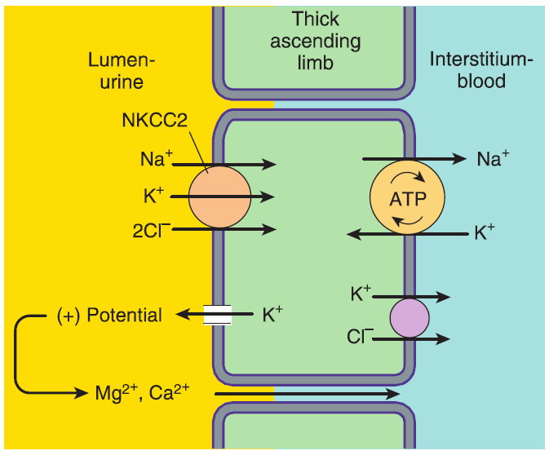

Slide 11
