Slide 1
Cancer
Dr. Armin Pourhosseini

Slide 2
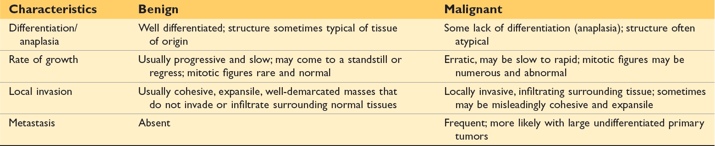
Use of cytotoxic anticancer drugs produces high rates of cure of a few cancers, which, without chemotherapy, result in extremely high mortality rates (eg, acute lymphocytic leukemia in children, testicular cancer, and hodgkin lymphoma).

Slide 3
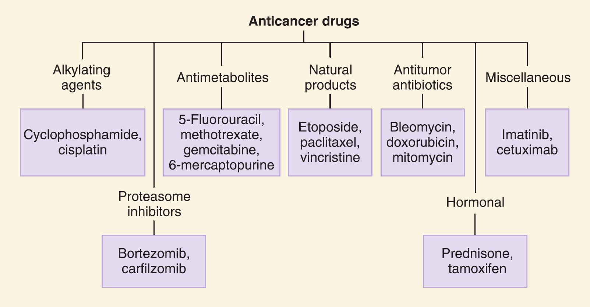

Slide 4
some anticancer drugs exert their actions selectively on cycling cells (cell cycle-specific [CCS] drugs), and others (cell cycle-nonspecific [CCNS] drugs) kill tumor cells in both cycling and resting phases of the cell cycle (although cycling cells are more sensitive).
Both types of drugs are most effective when a large proportion of the tumor cells are proliferating (ie, when the growth fraction is high).

Slide 5
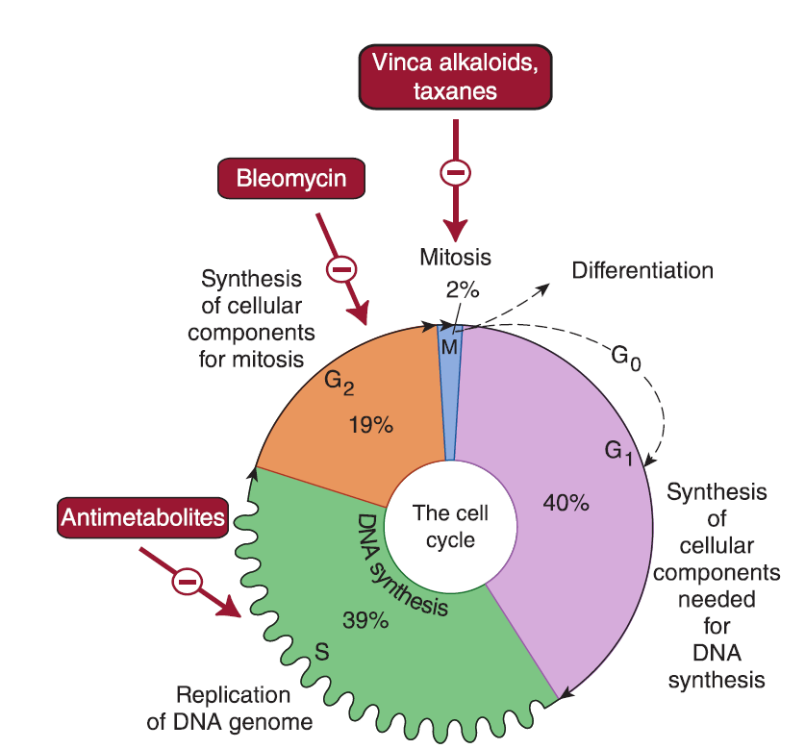

Slide 6
The Log-Kill Hypothesis
A given dose kills a constant proportion of a cell population rather than a constant number of cells.
the log-kill hypothesis proposes that the magnitude of tumor cell kill by anticancer drugs is a logarithmic function.

Slide 7
Resistance to anticancer drugs
increased DNA repair
formation of trapping agents
changes in target enzymes
decreased activation of prodrugs
inactivation of anticancer drugs
decreased drug accumulation

Slide 8
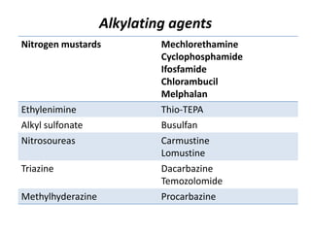

Slide 9
platinum analogs
(cisplatin, carboplatin, oxaliplatin)
the platinum agents are used intravenously; the drugs distribute to most tissues and are cleared in unchanged form by the kidney.
Clinical use: Cisplatin is commonly used as a component of regimens for testicular carcinoma and for cancers of the bladder, lung, and ovary. Carboplatin has similar uses. Oxaliplatin is used in advanced colon cancer.

Slide 10
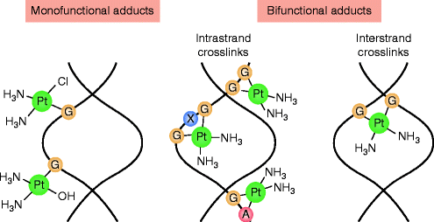

Slide 11
Toxicity of platinum-based compounds:
cisplatin causes gastrointestinal distress and mild hematotoxicity and is neurotoxic (peripheral neuritis and acoustic nerve damage) and nephrotoxic.
renal damage may be reduced by the use of mannitol with forced hydration.
carboplatin is less nephrotoxic than cisplatin and is less likely to cause tinnitus and hearing loss, but it has greater myelosuppressant actions.
Oxaliplatin causes dose-limiting neurotoxicity.

Slide 12
ototoxicity is the second most common cisplatin-related neurotoxic effect; it is characterized by a dose-dependent, high-frequency sensorineural hearing loss, which is almost always bilateral and irreversible, and often accompanied by tinnitus and vertigo. however, the exact incidence of tinnitus is unclear.

Slide 13
The main risk factors are cumulative dose, age at treatment, and the use of concomitant ototoxic treatments.
young children are at more risk of developing moderate to severe hearing loss from cisplatin than adults (sodium thiosulfate)
Vestibulotixicty

Slide 14
cisplatin-induced ototoxicity lesions usually appear in early stages (from hours to days after exposure), leading to symmetrical, progressive, irreversible, cumulative and dose-dependent bilateral sensorineural hearing loss.
the effect starts at doses from 60 mg/m2 per cycle. in high dose administration schedules, in the 150–225 mg/m2/dose range, up to 100% of patients have been found to be affected.
the hearing loss is associated with tinnitus, which affects the majority of patients exposed. some studies have demonstrated an elevated auditory threshold in 75%–100% of cisplatin-treated patients; among them, pediatric patients were found to be especially susceptible to cisplatin ototoxicity.

Slide 15
mechanism — the main targets of cisplatin- and carboplatin-related ototoxicity are the outer hair cells (OHCs) in the organ of corti and the vascularized epithelium in the lateral wall of the cochlea.
Oxidative stress?
this difference in risk of ototoxicity with oxaliplatin has been attributed to lower cochlear uptake as compared with cisplatin

Slide 16
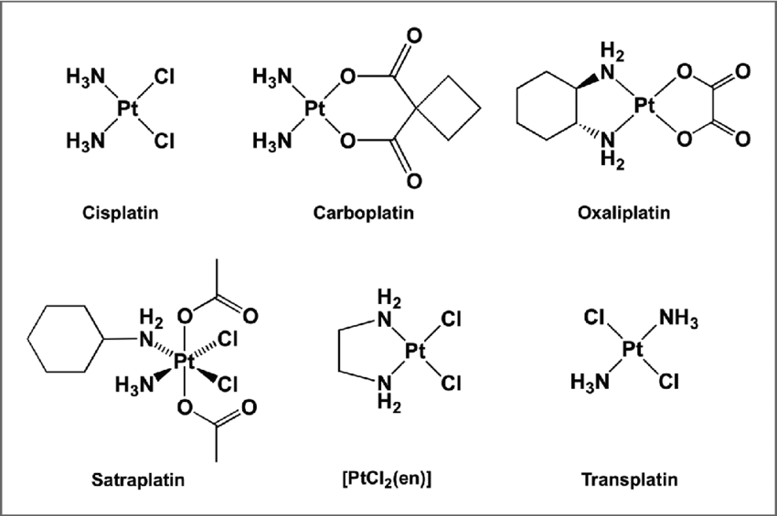

Slide 17
