Slide 1
NSAIDs
Dr Armin Pourhosseini

Slide 2
Quiz 1
Name at least four anti-spasm drugs.
Name at least four antispasticity drugs.
Why oral baclofen is not favorable in supraspinal spasticity? In what disease is baclofen a choice drug?
Compare IT and oral baclofen.

Slide 3
NSAIDs
Nonsteroidal anti-inflammatory drugs (vs glucocorticoids)
the ability to decrease inflammation,
the ability to relieve mild-to-moderate pain (analgesia),
the ability to decrease elevated body temperature associated with fever (antipyresis),
the ability to decrease blood clotting by inhibiting platelet aggregation (anticoagulation)

Slide 4
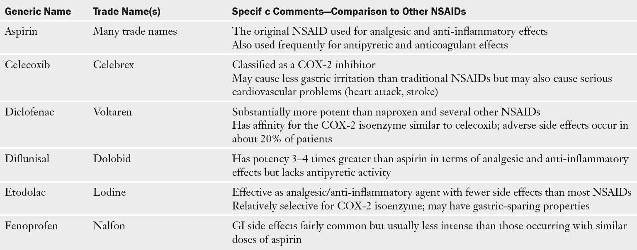

Slide 5
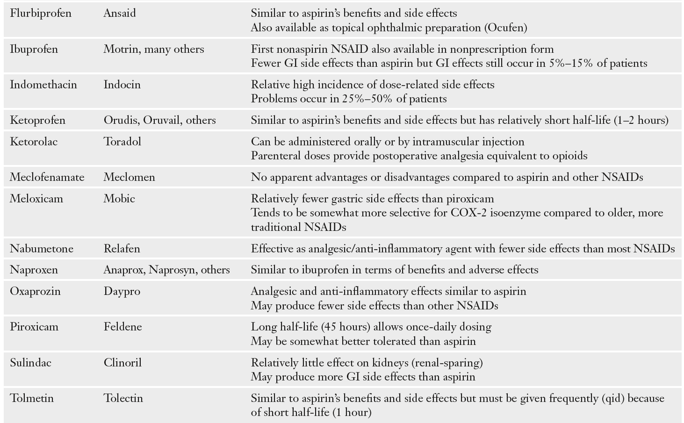

Slide 6
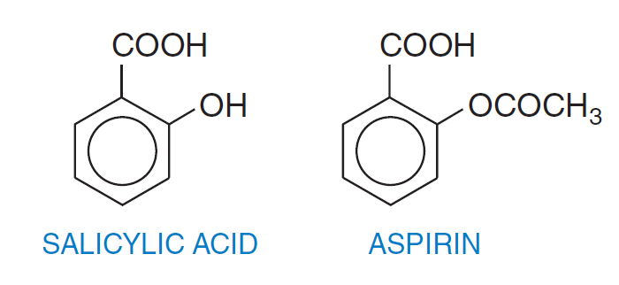
Aspirin & other NSAIDs
Aspirin = acetylsalicylic acid
Acetaminophen is similar to aspirin and other NSAIDs in its ability to decrease pain and fever, but it is not considered an NSAID because it lacks anti-inflammatory and anticoagulant properties.
Mechanism of action of NSAIDs: inhibition of biosynthesis of a group of endogenous compounds known collectively as the prostaglandins.

Slide 7
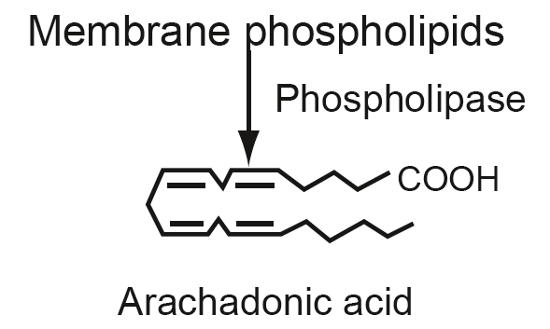
PGs, TxA2 & LTs
With the exception of the red blood cell, virtually every type of living cell in the human body is able to produce prostaglandins.
Regulate cell function under normal and pathological conditions.
often referred to as eicosanoids because they all are derived from 20-carbon fatty acids. The term eicosanoid is derived from eicosa, meaning “20-carbon,” and enoic, meaning “containing double bonds.”)

Slide 8
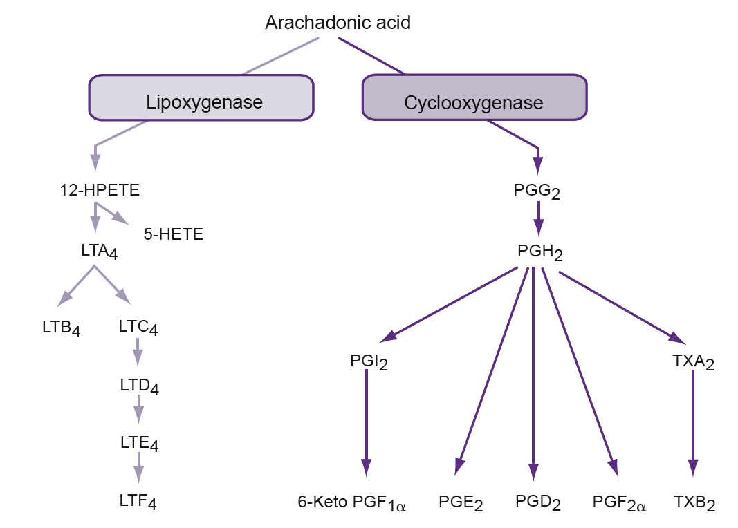
Biosynthesis

Slide 9
Exactly which pathway is used in any particular cell depends on the type and quantity of enzymes in that cell and its physiological status.
Any drug inhibiting COX or LOX will also inhibit the formation of all of the subsequent products of that particular pathway.
Aspirin and other NSAIDs do not inhibit the lipoxygenase enzyme and thus do not appreciably decrease leukotriene synthesis.
Like the prostaglandins, leukotrienes are pro-inflammatory but seem to be more important in mediating airway inflammation in conditions such as asthma and allergic rhinitis.

Slide 10
Role of Eicosanoids in Health and Disease
these compounds can influence cardiovascular, respiratory, renal, gastrointestinal (GI), nervous, and reproductive function.
can exert various effects on the same system: For instance, certain prostaglandins such as the PGIs and PGEs tend to produce vasodilation inmost vascular beds, whereas other prostaglandins (e.g., PGF2α) and the thromboxanes are often vasoconstrictors.
In general, cells that are subjected to various types of trauma or disturbances in homeostasis tend to increase the production of prostaglandins + painful effects of injury and inflammation

Slide 11
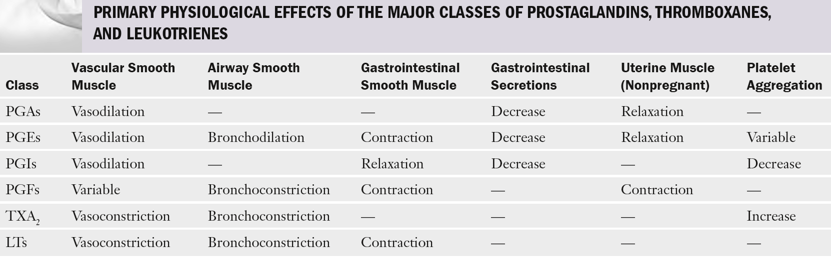

Slide 12
Excessive prostaglandin synthesis:
Inflammation
Pain
Fever
Dysmenorrhea
Thrombus formation
Other…

Slide 13
Inflammation
Certain prostaglandins, such as PGE2, are thought to help mediate the local erythema and edema associated with inflammation in certain tissues by increasing local blood flow and capillary permeability and potentiating the permeability effects of histamine and bradykinin
Leukotrienes, particularly LTB4, also contribute to the inflammatory response by increasing vascular permeability, and LTB4 has a potent chemotactic effect on polymorphonuclear leukocytes.
Pain
PGs do not usually produce pain directly but are believed to increase the sensitivity of pain receptors to mechanical pressure and the effects of other pain-producing substances such as bradykinin

Slide 14
Fever
It seems that prostaglandins produced locally by brain endothelial cells promote fever by altering the thermoregulatory set-point within the hypothalamus so that body temperature is maintained at a higher level
Thrombus formation
TXA2, cause platelet aggregations that result in blood clot formation

Slide 15
Mechanism of action
Aspirin and the other NSAIDs are all potent inhibitors of the cyclooxygenase enzyme (COX).
cyclooxygenase represents the first step in the synthesis of prostaglandins and thromboxanes
there are at least two primary subtypes (isozymes) of the COX enzyme: COX-1 and COX-2.
COX-3 ???

Slide 16
COX-1 vs COX-2
COX-1 help regulate normal cell activity and maintain cellular homeostasis (housekeeping functions): stomach mucosa, renal function
The COX-2 enzyme, however, seems to be produced primarily in injured cells. produces prostaglandins that mediate pain and other aspects of the inflammatory response. COX-2 often represents an “emergency” enzyme.
However, recent evidence suggests that prostaglandins produced by COX-1 are not always beneficial, and COX-2- induced prostaglandins are not always harmful.
prostaglandins produced by the COX-2 enzyme, for example, may help lower blood pressure and prevent arterial thrombosis that would otherwise cause heart attack and stroke in susceptible individuals
Aspirin and most of the traditional NSAIDs are nonselective

Slide 17
Aspirin: the prototypical NSAID
Aspirin is the oldest NSAID, and other NSAIDs are often compared with aspirin in terms of efficacy and safety.
an important medication for preventing thromboembolic conditions (e.g., heart attack, stroke) and possibly preventing certain forms of cancer.
Clinical applications:
  Pain and inflammation
  Fever
  Vascular disorders
  Prevention of cancer

Slide 18
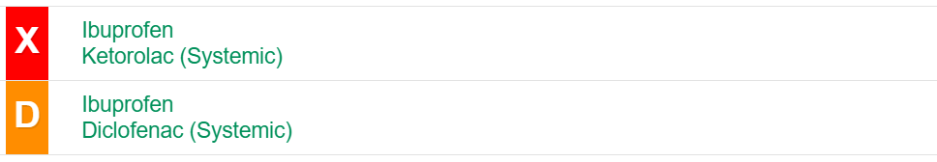
Adverse effects:
Gastrointestinal problems:
Minor stomach discomfort to variable amounts of upper GI hemorrhage and ulceration are fairly common. loss of protective prostaglandins (PGI2 and PGE2) from the mucosal lining.
Protection by inhibiting gastric acid secretion, increasing the production of mucus in the stomach lining, and maintaining blood flow to the gastric mucosa.
Certain patients are more susceptible to GI injury from aspirin-like drugs. as advanced age, a history of ulcers, use of multiple NSAIDs, use of high doses of an NSAID, and use of other agents (e.g., anti-inflammatory steroids, anticoagulants), Helicobacter pylori infection
Enteric-coated aspirin ???

Slide 19
Adverse effects
Cardiovascular problems:
Loss of PGI2 and PGE2 can result in increased blood pressure and increased clotting activity that can lead to myocardial infarction and stroke in susceptible individuals.
Rofecoxib, Valdecoxib
the risk of cardiovascular problems increases if the drug is more selective for the COX-2 isoenzyme.
Other side effects: hepatitis, Reye’s syndrome ???
It might be prudent to avoid the use of NSAIDs immediately following fracture or bone surgery

Slide 20
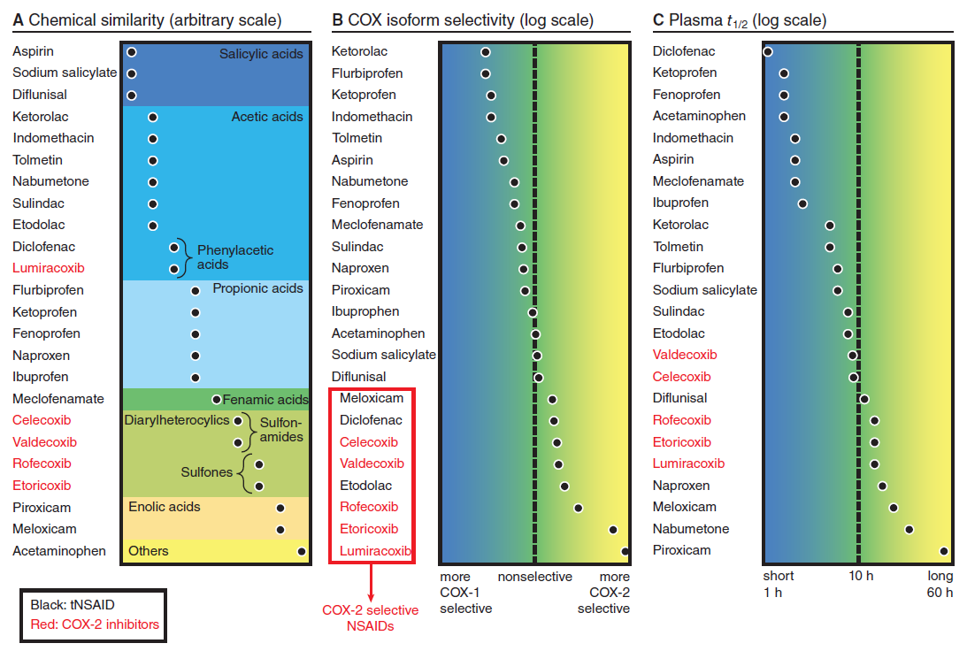

Slide 21
Aspirin vs other NSAIDs
Selection of medication? Now what?
Patient risk factors
Prior experiences
Use of concurrent drugs
Desired effect (anti-inflammatory or analgesic)/ different effectiveness of drugs

Slide 22
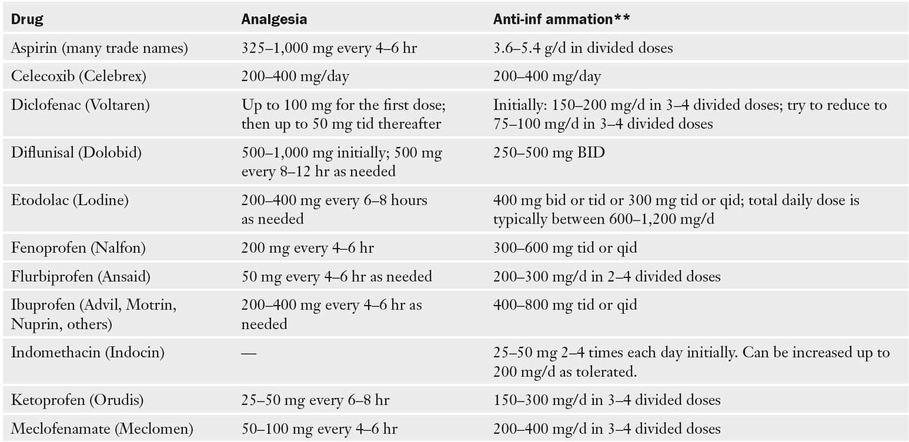

Slide 23
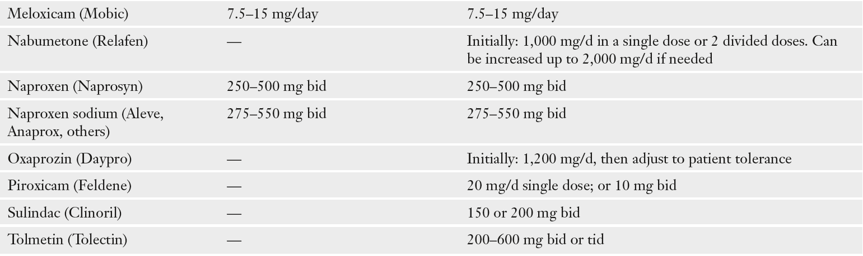

Slide 24
Acetaminophen
Paracetamol
Acetaminophen is often equal to aspirin and NSAIDs in terms of analgesic and antipyretic effects, but it does not have any appreciable anti-inflammatory or anticoagulant effects.
it is not associated with upper GI tract irritation.
Why acetaminophen fails to exert anti-inflammatory and anticoagulant effects is unclear. One explanation is that this drug preferentially inhibits central nervous system (CNS) prostaglandin production but has little effect on peripheral cyclooxygenase activity + COX-3

Slide 25


Slide 26
THANKS
FOR
YOUR ATTENTION

